Slide 1


An analysis of 2-way communications
in social media
SOCIAL MEDIA LAB - SAVANAH SALAZAAR

Slide 2


Quick review of
2-way communications
an exchange between the stakeholder and the organization
Two-way communication:
Two-way symmetrical communication:
balance of power or interest so that communications is going back and forth, interests are being expressed on both sides

Slide 3

Background
Origins of the project
Conducted in 2014
- The researchers participated in Generally Accepted Practices Research Project (GAP) through the funding of CPRS
Through their attendance in GAP, they found the following:
  Social media is a core and growing part of PR practitioners' practice
  Measurement and evaluation of this continues to be challenging for PR practitioners
  The senior decision makers are both happy to have social media and are afraid of the lack of control
Research project done by:
Dr. Amy Thurlow
Dr. Alla Kushniryk
Alyssa Simon

Slide 4

Areas of Concern
CONTROL AND MEASUREMENTS IN SOCIAL MEDIA
  Should an organization have a social media policy to gain control or a social media strategy to integrate social media into the organization?
  How does one measure and evaluate social media?

Slide 5

62%
53%
OF RESPONDENTS HAVE A FORMAL WRITTEN SOCIAL MEDIA POLICY
OF RESPONDENTS HAVE A SOCIAL MEDIA STRATEGY
24%
35%
OF RESPONDENTS HAVE A WRITTEN INFORMAL SOCIAL MEDIA POLICY
OF RESPONDENTS HAVE A PLAN TO IMPLEMENT A STRATEGY
8%
14%
OF RESPONDENTS NO PLANS TO HAVE A SOCIAL MEDIA STRATEGY AT ALL
OF RESPONDENTS NO SOCIAL MEDIA POLICY

Slide 6

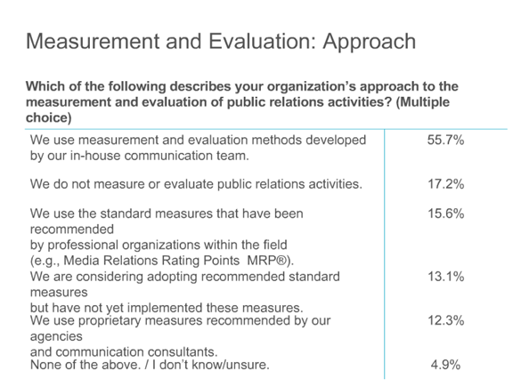

THE MAJORITY
OF PRACTITIONERS ARE
NOT USING
A
STANDARDIZED METHOD
OF
EVALUATION

Slide 7
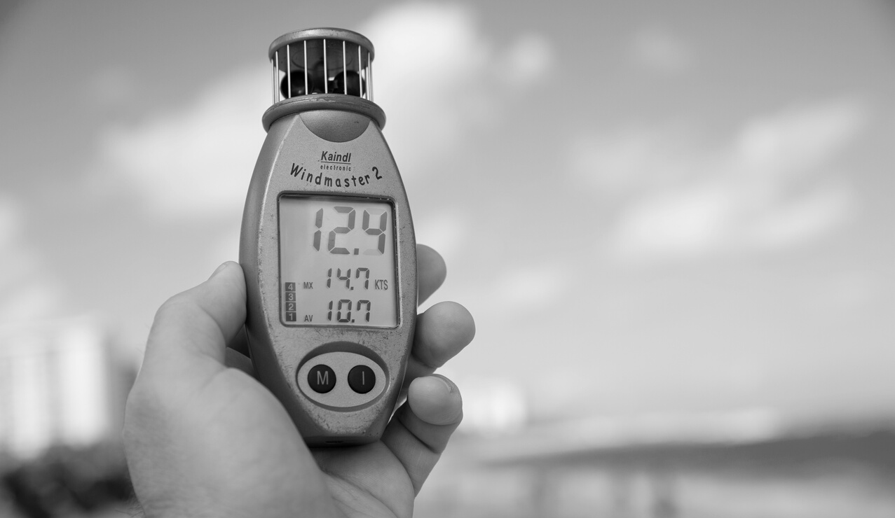
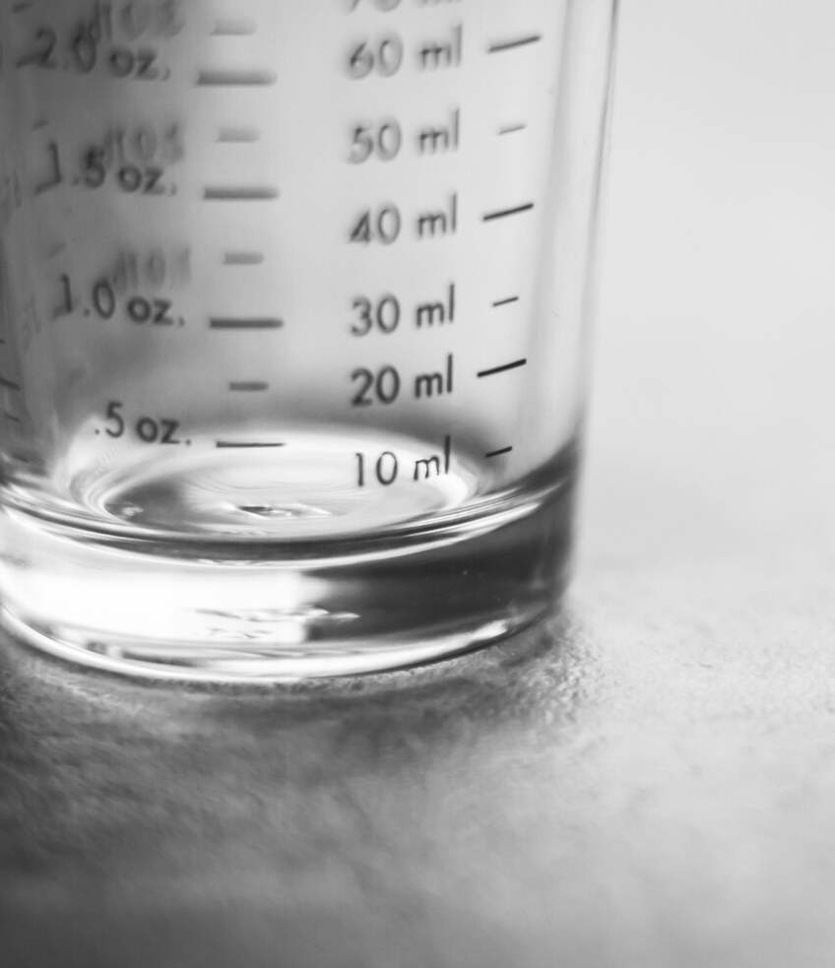

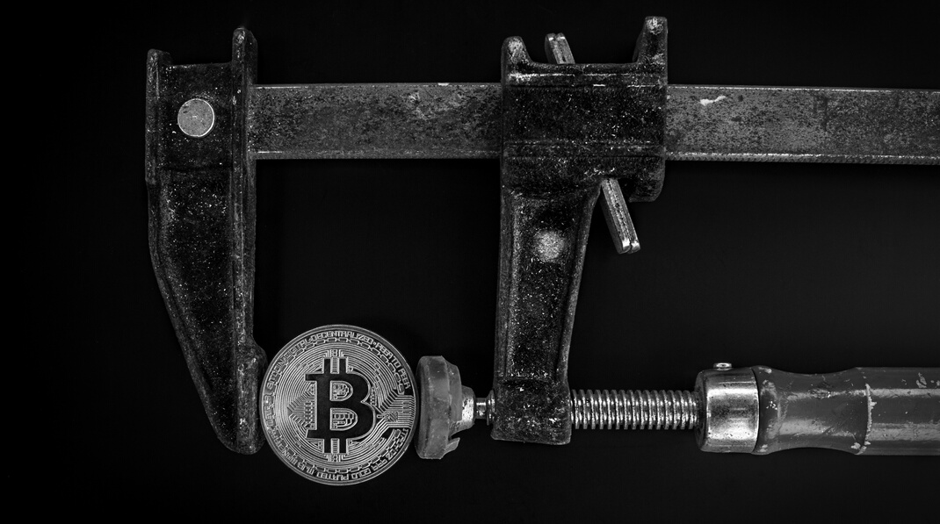
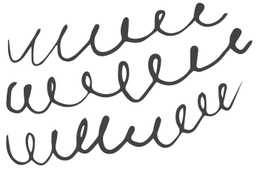
MEASUREMENT TOOLS
Social Media tools are used to measure the majority of public relations initiatives
Social Media tools used:
  Likes, retweets, friends, website traffic, network size and followers

Slide 8

The Challenges
  Through a literature review, they found that the challenge facing many companies is that although they recognize the need to be active on social media, they do not truly understand how to do it effectively, what performance indicators they should be measuring and how they should measure them.
  Social media is key to the development and maintenance of two-way communication with stakeholders. There is very little research to understand measuring two-way communication via social media channels.

Slide 9

The Goal
Build a model that could be used as a metric of measurement for social media activities

Slide 10


Proposal to the communications and
public relations foundation
  Identify 2-way symmetrical communication, measure interactive communications with stakeholders and the nature of meaningful relationships online.
  Use visual mapping and Grunig's Excellence Theory translated to social media
  Visual mapping of two-way communication in social media will allow PR practitioners to better integrate and measure the impact of two-way communication.
  Excellence Theory states that the key to excellent PR is that it has to be a management function, has to be involved in strategic communications and has to be part of the dominant coalition, based on managerial decision making and not technical. As well, they need to have a two-way symmetrical model of public relations.
What would Excellent social media look like?

Slide 11


How do we measure excellent social media?
They decided to create a visual mapping toolkit:
  Qualitative (interviews) and Quantitative (network analyzers) approaches
  Triangulation of data (in excel spreadsheet)
  Visualizations (visual maps)
  Network analysis
  Textual analysis of key terms (from the networks)
  Coding of emergent themes
This project attempted to measure the degree to which their online communication is in fact two-way in nature.

Slide 12
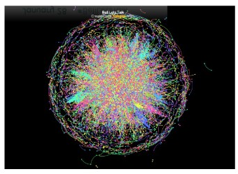
Example of a Visual Maps
Bell let's talk
It was centralized but the message wasn't really being shared, the meaning was about something very different
Each point of colour is interaction with a member of the data, circles or curves are hubs where the messages have influence and the different colours show different conversations.

Slide 13
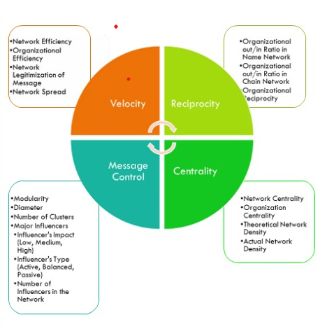
The Visual Mapping Toolkit
of social media usage

Slide 14

Velocity
Centrality
- It is how centralized or decentralized the organizational network is. Excellence is achieved by having a balanced centrality.
- It is how quickly the message spreads and resonates with the audience.
Message control
Reciprocity
- It is how well an organization controls information flow within its network.
It is a multidimensional category consisting of:
  Modularity
  Diameter
  Number of Clusters
  Major Influencers (those posting, impact, etc)
- It is how successful an organization is in engaging in conversations with its network members and in initiating conversations among its network members.

Slide 15

The conclusion
  The purpose of the study was to investigate the possibilities of visual mapping two-way communication in social media networks.
  Key dimensions established are velocity, reciprocity, centrality and message control.
  WHAT'S NEXT: Coming up with a measurement for the dimensions, and make it more accessible to practitioners

