Slide 1

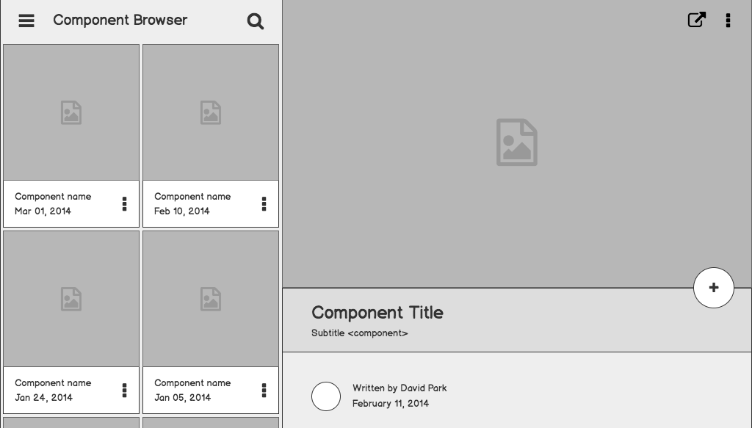

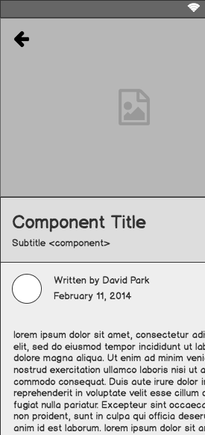
PR in the Micro-Moment
Webinar by Martin Waxman
Presented by Alexander Kelly

Slide 2

Background
Every experience we have begins with a search
The media used to be the most important discovery engine
Underscores the value of public relations
Now, we turn to search engines to find out news and information
Search engines are the new front page

Slide 3

Market Landscape
By 2020, half of all search discoveries are made with voice search function
70% of market is controlled by five companies; Amazon’s Alexa, Apple’s Siri, Google Home, Samsung’s Bixby and Microsoft’s Cortana
Silicon Valley analyst says that Google’s voice recognition is now at 95%, which is almost the same as humans
Voice technologies are becoming more indistinguishable from humans
AI voice assistants are merging with furniture, cars and other home appliances
Appliances are becoming the newest advertising and communications platforms

Slide 4


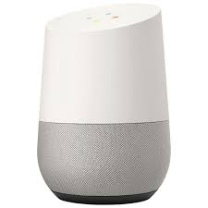
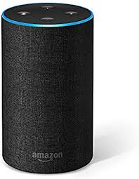
Market Landscape Cont’d
Organizations will no longer compete for the top 10 search spots, but rather top 2
Will these results be organic or paid?
Ethical and privacy concerns are raised regarding the transition to voice search
Encourages customer-centric approach to drive attention
Voice searches mean communicators must think harder about questions that audiences are asking and develop content to address it

Slide 5
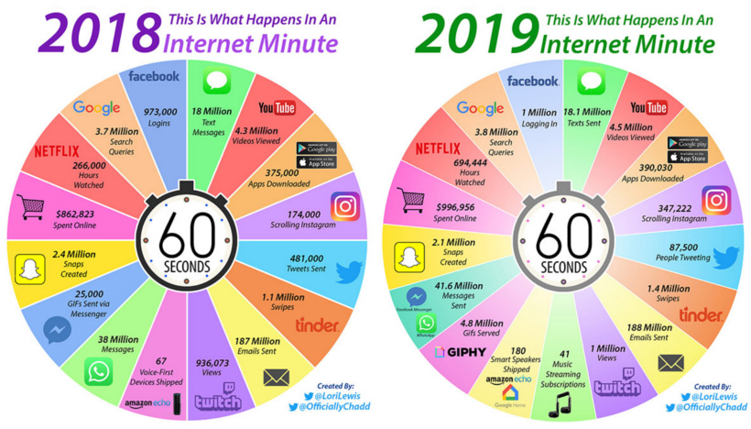
Internet Minute from 2018 to 2019.

Slide 6

The Concept of Micro-Moments
Mobile searches have gone from 2% to 79% in 10 years
The screen is number 1
77% of online adults own a smartphone
94% in the 19-29 year old demographic own a smartphone
75% of us think our smartphones are making us more productive
(Alameda Research)

Slide 7
What are Micro-Moments?
While in the middle of an activity or task, reflexively using smartphone to find out certain information
91% of us do it on a daily basis:
I want to know - news, information and generating awareness
I want to go - location, event, reach people physically or virtually
I want to do - ideas, tips, feature stories
I want to buy moments - purchasing products

Slide 8
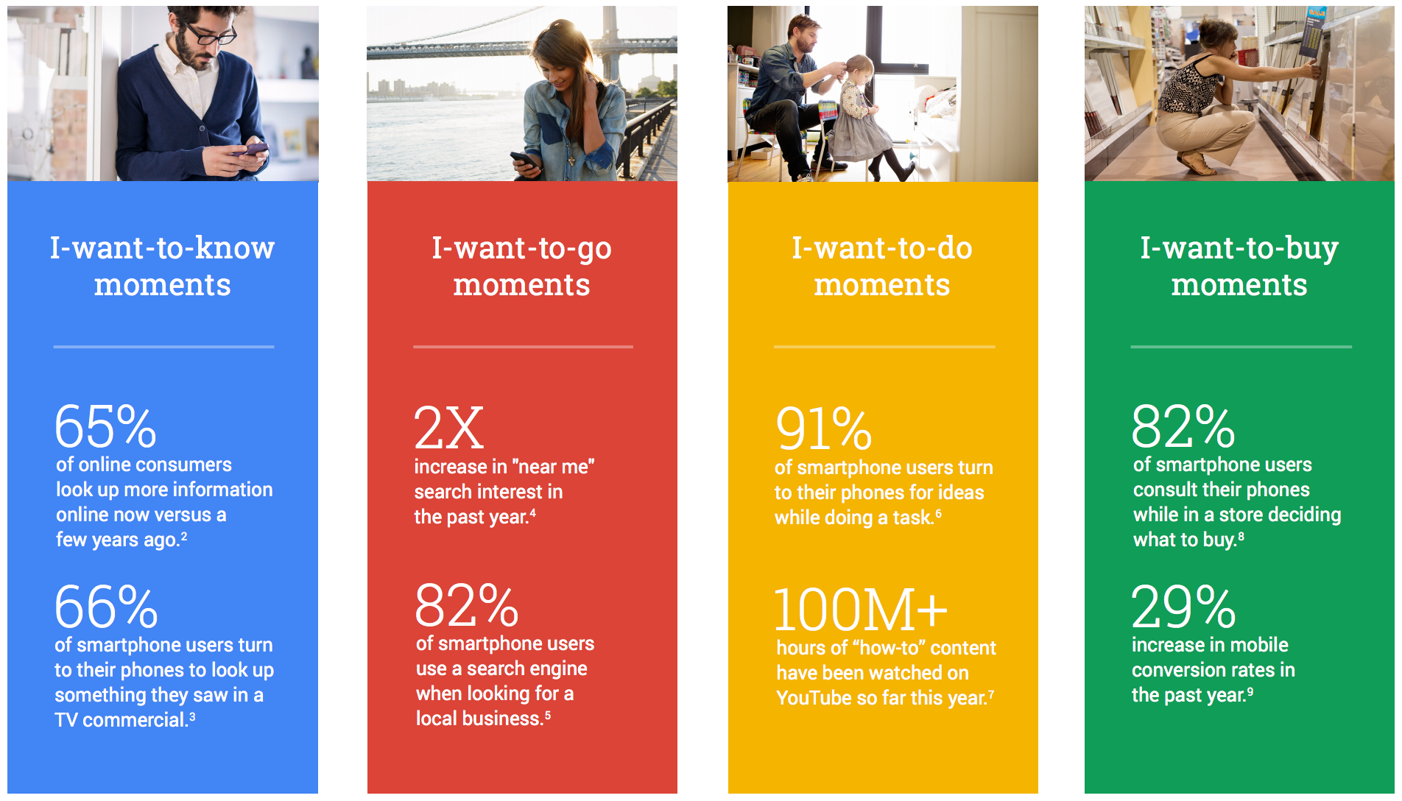
Micro-Moment graphic.

Slide 9
What are Micro-Moments? Cont’d
They are part of our transactive memory
The way we encode and store our memories
We our outsourcing this part of our brains to Internet search engines
WRONG: How micro-moments impact the way we develop and cover stories?
CORRECT: Are we there? When a travel blogger needs information, a reporter notices activity or when a customer has questions, where are we?

Slide 10
Question...
How often do you experience micro-moments? Would you like to have more or less? Are you conscious of them?
Do you think your smartphone makes you more or less productive?

Slide 11
Intent Trumps Demographics
We miss 70% of customers when we focus solely on demographics
Time pressure in a decision can alter loyalty
45% of home improvement searches are done by women
Home Depot realized customers are increasingly searching for DIY and created a content library for men and women based off content searches and audience intent
9/10 people are not certain of the brand they want when searching
80% of people buy not from loyalty, but from companies that answer questions
Daniel H. Pink’s ‘Drive’, speaks about what your audience is looking for including pain points, text, photo, video, friends, etc.
Example - If a person’s flight is cancelled, they will most likely choose first nearby hotel available

Slide 12

What is a Desired Path?
All the shortcuts we take to our goal or destination
Mobile phones users care more about functions than appearance
Form is better than aesthetics on applications
Make the experience seamless for users and customers
User-friendly is more important than design, though design is still important
Learn what channels people are using
Location and accessibility is everything for micro-moments
⅔ of us switch to new sites if process takes too long to purchase product or deliver service
61% of us are more likely to choose site that tailors to our location (near me)

Slide 13
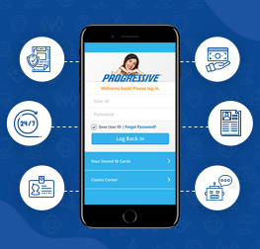
Example 1 - Progressive Insurance
Developed an application designed to process accident claims
Received complaints about too many screens and steps involved in the process
Progressive reduced screens and number of steps in response
35% increase in completion rate of claims on mobile application

Slide 14
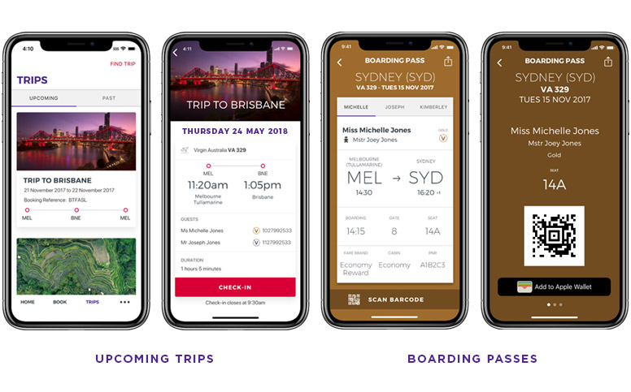
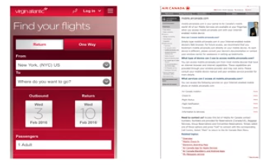
Example 2 - Virgin vs Air Canada

Slide 15

Example 3: Westworld at SXSW 2018

Slide 16

Life in the Fast Lane
Nearly ½ of smartphone users switch to new app/site if current one is too slow
Fast load time is essential
Remove poor visuals or ads that cause loss of interest
Optimize your communications for mobile devices
40% of shoppers will give up on travel or retail site that does in load in 3 seconds
Traditional news release format is becoming less effective for public use
Especially for clients that don't have regulatory compliance
Regular news is inconvenient to read in traditional format and will eventually reach digital space
Customers will not engage with news and information in traditional form

Slide 17
How to Adapt the News Release?
Headlines answer the most important questions
Use words and phrases that are being searched often
Adds visuals, graphics and infographics
Incorporate video
80% of bloggers and online media will use video as produced
95% of us watch video vertically on mobile phones
Make it compatible for popular formats
Audiences will discover what they need to know

Slide 18
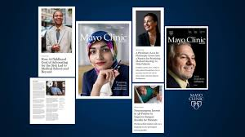
Example - Mayo Clinic
Number 1 source of healthcare information is US
They video record quotes in news release instead of text
Provides headshot and intro/outro slide
Placed at top of story
Gets picked up by news outlets

Slide 19
Question...
What is the most important factor of a mobile app? Appearance? Function? Aesthetics? Speed?
Are there any downsides to changing the current blueprint of news releases? Attention span? Clickbait?

Slide 20
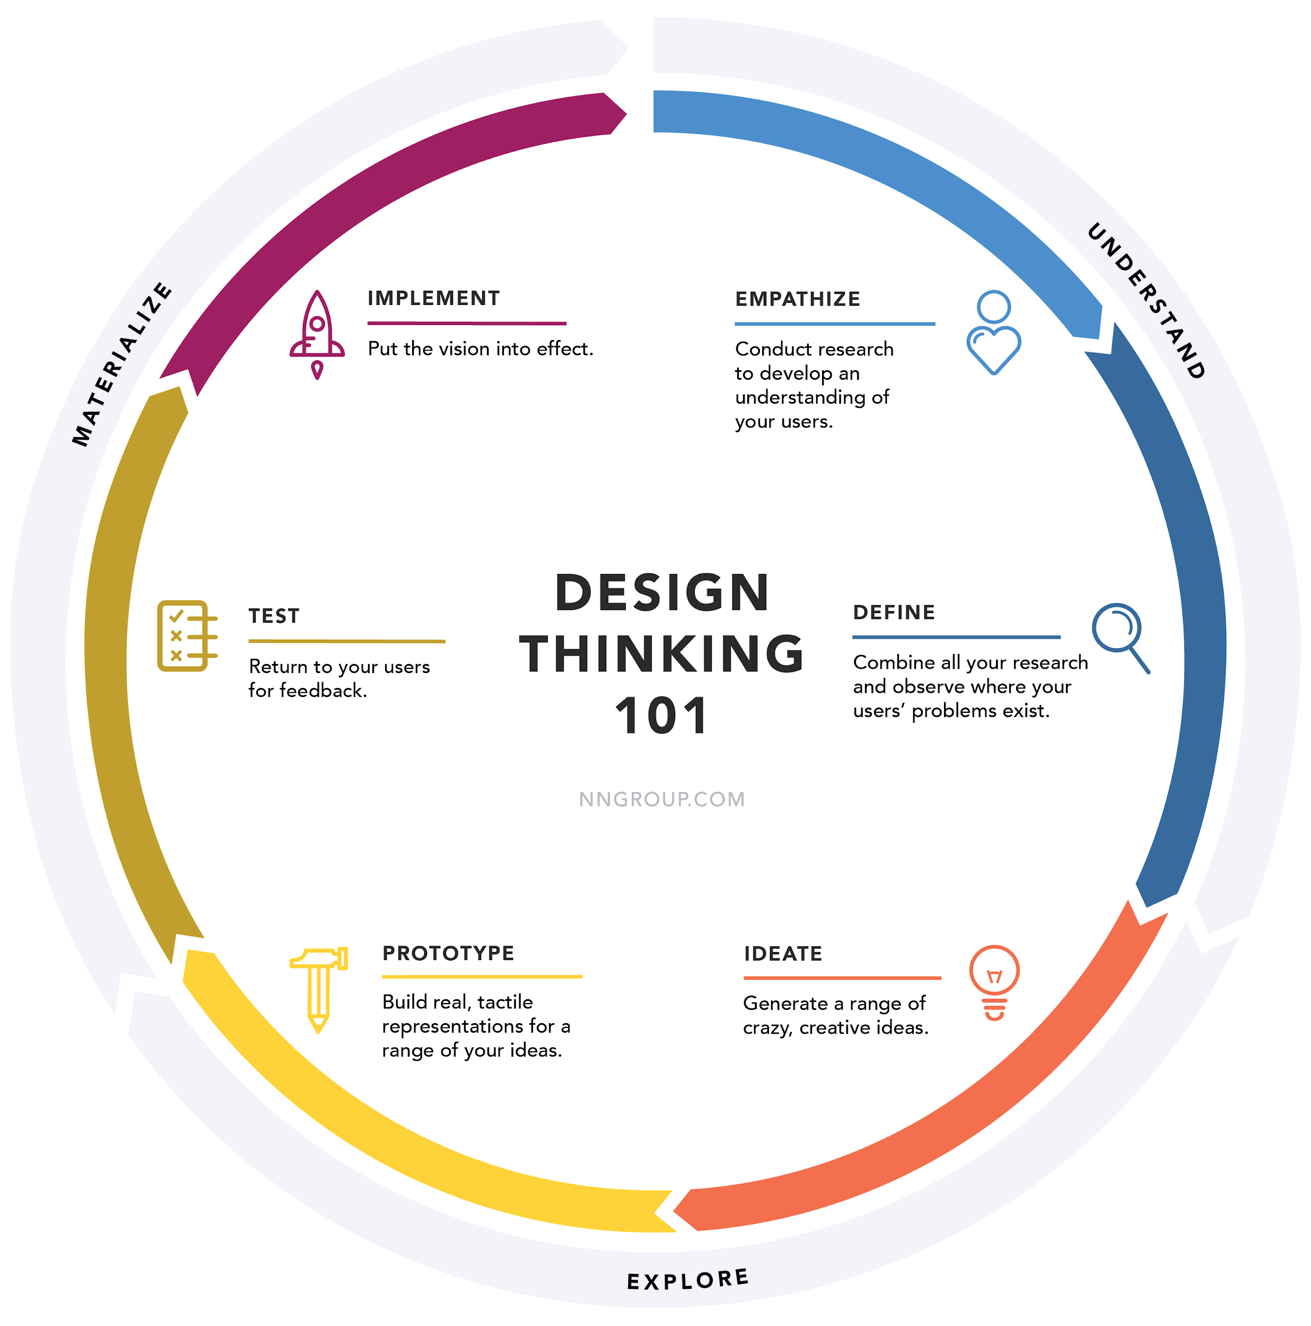
Design Thinking graphic.

Slide 21

A New Pair of Shoes
Reaching people in the micro-moment must be helpful, creative and break through clutter
Step into the audience’s shoes and see the world from their perspective
Map customer experiences and behaviours
Determine how you can help them
According to Jenna Wortham, NYT, “News is no longer new when it happens. It’s news when people discover it.”
Important in issue and crisis situations
Secret of comedy = timing
Micro-moments are all about timing!

Slide 22
Question...
Should organizations address old news? When do you address and when do you ignore it?
What brands or services could benefit from a transition to mobile applications and improved micro-moments?

Slide 23
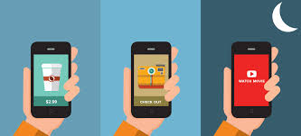
The End
Thank you for listening!

